Slide 1
3rd Semester Mini project: Review 2 Project Title : Airline Ticketing System
Team Details
1CR20IS005 : Aayush Kumar
1CR20IS128 : Ritik Kumar Singh
Under the Guidance of
Dr.Vijyalakshmi V. Asst. professor ISE Dept.

Slide 2
AGENDA
Abstract
Implementation details
Work Completed
Work yet to complete
Conclusion

Slide 3
ABSTRACT
This project on Airline Ticketing System is the automation of registration process of airlines system. The system provides information like passenger’s information, flight information, list of all passengers, it allows storing and retrieving data related to the airline industry and make transactions related to air travel etc. The system also allows us to add records when a passenger reserves a ticket. For data storage and retrieval we use MySQL Database. It enables us to add any number of records in our database. The project “Airline Management System” comprises of a large number of flights which belong to a particular airline. The system we have implemented manages different objects viz.
· Airline
· Airline Employees
· Customers/Traveller
Each of these accesses a database schema which has corresponding tables.
Language Used - Java Core
IDE Used - NetBeans
Database Used - MySQL

Slide 4
Implementation Details
5.1 Backend Implementation
MYSQL
MySQL is an open-source relational database management system (RDBMS). A relational database organizes data into one or more data tables in which data types may be related to each other; these relations help structure the data. SQL is a language programmers use to create, modify and extract data from the relational database, as well as control user access to the database. In addition to relational databases and SQL, an RDBMS like MySQL works with an operating system to implement a relational database in a computer's storage system, manages users, allows for network access and facilitates testing database integrity and creation of backups.

Slide 5
Table cancellation:
create table cancellation(pnr_no varchar(10), cancellation_no varchar(10), cancellation_date DATE, fli_code varchar(15));
Table flight:
create table flight(f_code varchar(10), f_name varchar(20), src varchar(30), dst varchar(30));
Table login:
create table login(username varchar(20), password varchar(20));
Table passenger:
create table passenger(pnr_no varchar(10), address varchar(30), nationality varchar(15), name varchar(20), gender varchar(10), ph_no varchar(15), passport_no varchar(20), fl_code varchar(10));
Table payment:
create table payment(pnr_no varchar(10), ph_no varchar(15), cheque_no varchar(15), card_no varchar(20), paid_amt varchar(10), pay_date DATE);
Table reservation:
create table reservation(pnr_no varchar(10), ticket_id varchar(10), f_code varchar(10), jny_date DATE, jny_time varchar(10), src varchar(20), dst varchar(20));
Table sector:
create table sector(flight_code varchar(20), capacity varchar(10), class_code varchar(5), class_name varchar(20));

Slide 6
Frontend Implimentations
Java Core:
Core Java is the part of Java programming language that is used for creating or developing a general-purpose application. It uses only one tier architecture that is why it is called as ‘stand alone’ application.Core java programming covers the swings, socket, awt, thread concept, collection object and classess.
XAMPP Control:
XAMPP is a free and open-source cross-platform web server solution stack package developed by Apache Friends,consisting mainly of the Apache HTTP Server, MariaDB database, and interpreters for scripts written in the PHP and Perl programming languages. Since most actual web server deployments use the same components as XAMPP, it makes transitioning from a local test server to a live server possible.
XAMPP's ease of deployment means a WAMP or LAMP stack can be installed quickly and simply on an operating system by a developer, with the advantage that common add-in applications such as WordPress and Joomla! can also be installed with similar ease using Bitnami

Slide 7
5.3 Creating mainframe class
package airline.ticketing system;
import net.proteanit.sql.DbUtils;
import java.awt.*;
import javax.swing.*;
import java.awt.event.*;
public class Mainframe extends JFrame{
public static void main(String[] args) {
new Mainframe().setVisible(true);
}
public Mainframe() {
super("AIRLINE RESERVATION TICKETING SYSTEM");
initialize();
private void initialize() {
setForeground(Color.CYAN);
setLayout(null);
JLabel NewLabel = new JLabel("");
NewLabel.setIcon(new ImageIcon(ClassLoader.getSystemResource("airline/management/system/icon/front.jpg")));
NewLabel.setBounds(0, 0, 1920, 990);
add(NewLabel);
JLabel AirlineManagementSystem = new JLabel("AIR INDIA WELCOMES YOU");
AirlineManagementSystem.setForeground(Color.BLUE);
AirlineManagementSystem.setFont(new Font("Tahoma", Font.PLAIN, 36));

Slide 8
AirlineManagementSystem.setBounds(700, 60, 1000, 55);
NewLabel.add(AirlineManagementSystem);
JMenuBar menuBar = new JMenuBar();
setJMenuBar(menuBar);
JMenu AirlineSystem = new JMenu("AIRLINE SYSTEM");
AirlineSystem.setForeground(Color.BLUE);
menuBar.add(AirlineSystem);
JMenuItem FlightDetails = new JMenuItem("FLIGHT_INFO");
AirlineSystem.add(FlightDetails);
JMenuItem ReservationDetails = new JMenuItem("ADD_CUSTOMER_DETAILS");
AirlineSystem.add(ReservationDetails);
JMenuItem PassengerDetails = new JMenuItem("JOURNEY_DETAILS");
AirlineSystem.add(PassengerDetails);
JMenuItem SectorDetails_1 = new JMenuItem("PAYMENT_DETAILS");
AirlineSystem.add(SectorDetails_1);
JMenuItem Cancellation = new JMenuItem("CANCELLATION");
AirlineSystem.add(Cancellation);
JMenu Ticket = new JMenu("TICKET");
Ticket.setForeground(Color.RED);
menuBar.add(Ticket);
JMenu List = new JMenu("LIST");

Slide 9
List.setForeground(Color.BLUE);
menuBar.add(List);
JMenu Misc = new JMenu("MISC");
Misc.setForeground(Color.RED);
menuBar.add(Misc);
FlightDetails.addActionListener(new ActionListener(){
public void actionPerformed(ActionEvent ae){
new Flight_Info();
}
});
ReservationDetails.addActionListener(new ActionListener(){
public void actionPerformed(ActionEvent ae){
try {
new Add_Customer();
} catch (Exception e) {
e.printStackTrace();
}
}
});

Slide 10
PassengerDetails.addActionListener(new ActionListener(){
public void actionPerformed(ActionEvent ae){
try {
new Journey_Details();
} catch (Exception e) {
e.printStackTrace();}
});
SectorDetails_1.addActionListener(new ActionListener(){
public void actionPerformed(ActionEvent ae){
try {
new Payment_Details();
} catch (Exception e) {
e.printStackTrace();
}
}
});
Cancellation.addActionListener(new ActionListener(){
public void actionPerformed(ActionEvent ae){
new Cancel();
}
});
setSize(1950,1090);
setVisible(true);
}
}

Slide 11
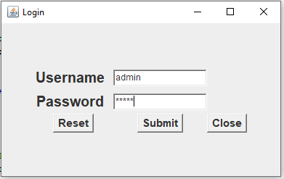
RESULT ANALYSIS

Slide 12
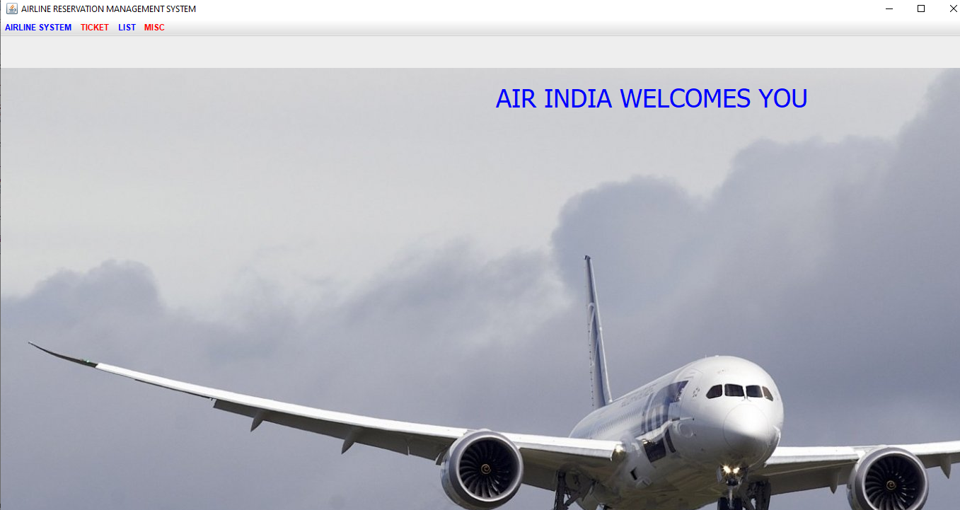
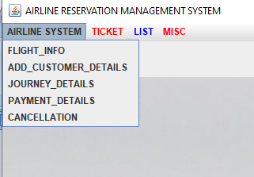
Mainframe
Drop Down Menu

Slide 13
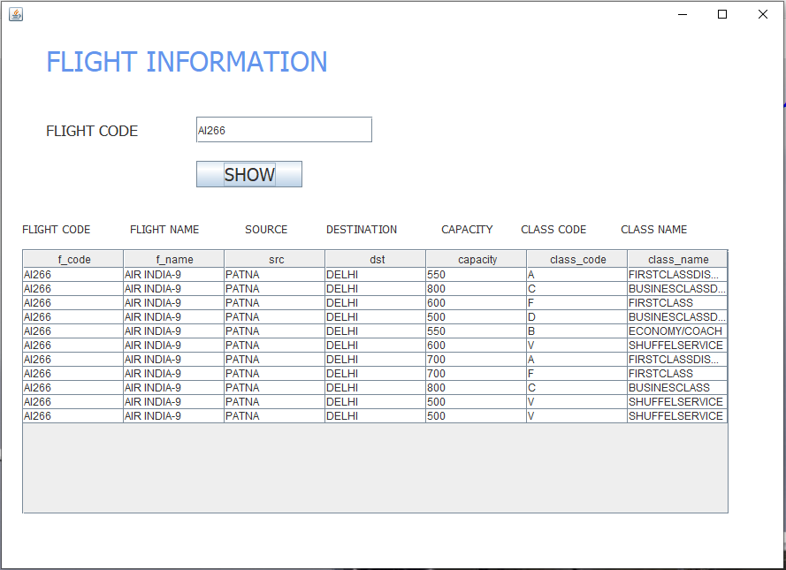
Flight Information

Slide 14
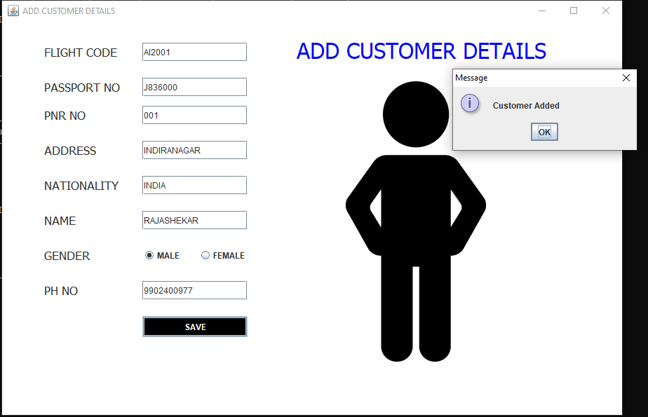
Adding Customer

Slide 15
CONCLUSION
This project on Airline Ticketing System is the automation of registration process of
airline system. The system is able to provide much information like passenger’s details, flight
details and the booking details. The system allows us to add records when a passenger reserves a ticket. It also allows to delete and update the records based on passenger’s requirements. This project has guided our path through various aspects of computer science where developing online application plays a major role.

Slide 16


